Slide 1
College Bazaar
Kelly Weber, James Moir, Patrick Isho, Trevor Drozd, Spenser Grzadzinski, Alissa Barnard

Slide 2
Sprint Schedule
Sprint 5 (10/26-11/8)
GCP script implementation for making updates in the work environment live in a more user friendly manner
Connecting application and website to database
Website Design and structure
Secure a domain name and make the website reachable by itv

Slide 3
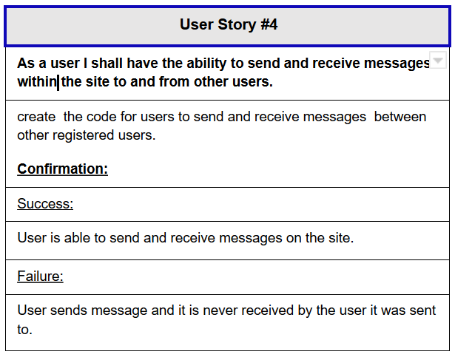
Messaging
User Story #4. As a user I shall have the ability to send and receive Messages to and from other users.

Slide 4

Messaging Demo

Slide 5
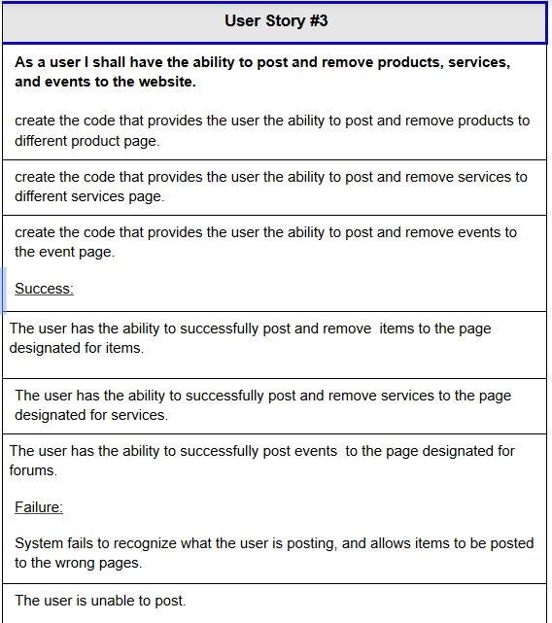
Events
User Story #3. As a user I shall have the ability to post and remove products, services, and events to the website.

Slide 6
Events Demo

Slide 7
Services
User Story #3. As a user I shall have the ability to post and remove products, services, and events to the website.

Slide 8
Services Demo

Slide 9
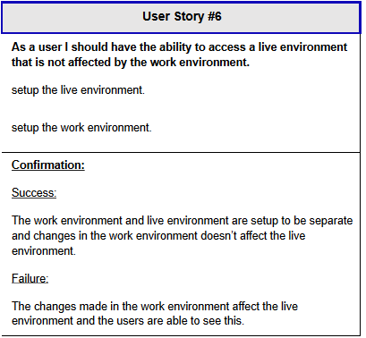
Stable Live Environment
Live environment now stable
Completely separate from test environment
As functional as working portions of development

Slide 10
Live Demo

Slide 11
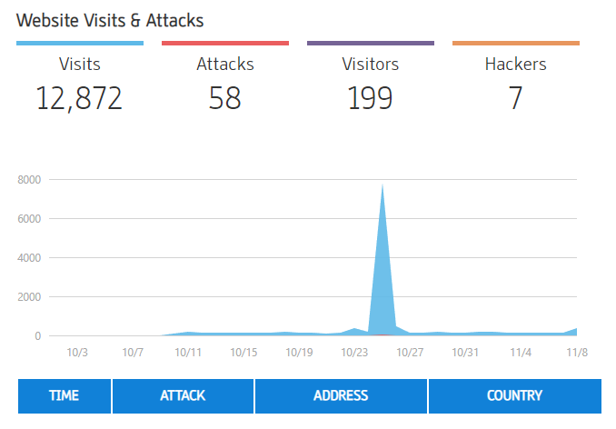
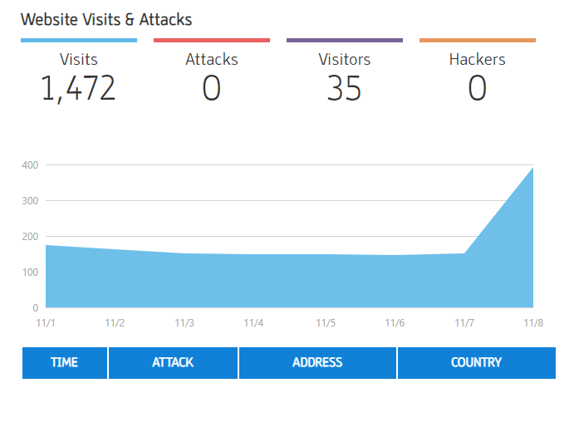
Security

Slide 12
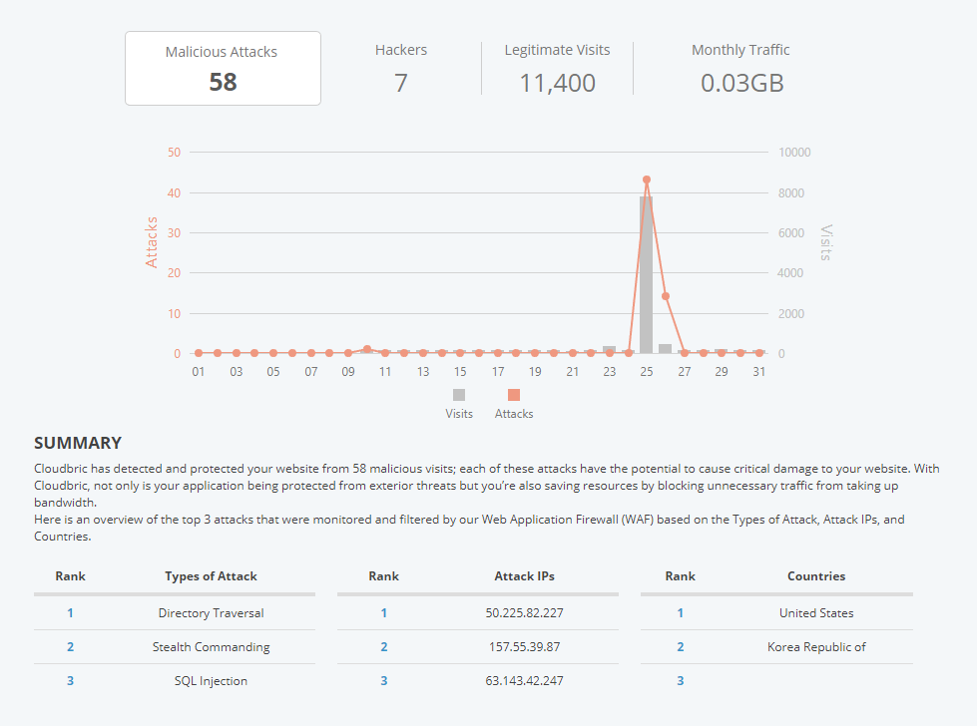
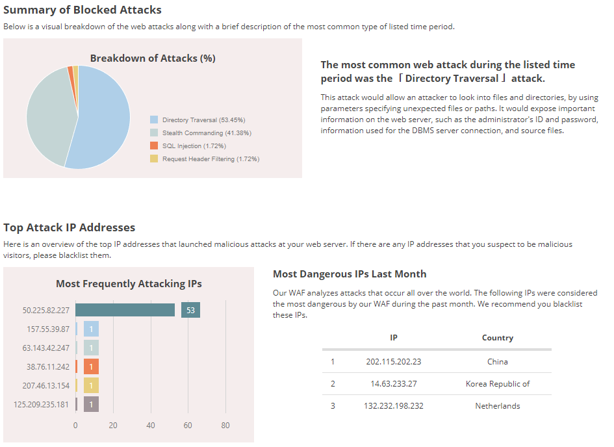
Security

Slide 13
Conclusion
On pace with initial Sprint schedule
Polish up pages
Make functionality run smoother
Work on adding non-functional requirements
Users can now add/remove products, events, and services
Users are now able to directly message senders on their posts

